Slide 1


Slide 2

LEADING WITH ENTHUSIASM

Slide 3
PLAY VIDEO
“Excited train guy”

Slide 4
Enthusiasm can be defined as great EXCITEMENT for, or interest in, a subject or cause.

Slide 5
Passion is the FUEL of our ministry – it gives us the energy to work hard.
Because in youth ministry the results are not always IMMEDIATE or obvious, sometimes it can be hard to REMAIN enthusiastic.

Slide 6
FOCUS on the right things.
EXTERNALIZE your enthusiasm.

Slide 7
PLAY VIDEO
“Enthusiastic football interview”

Slide 8
We may not all be able to do an epic speech like this guy,
but we do need to COMMUNICATE and EXPRESS our enthusiasm to those we are leading.

Slide 9
One way we can express our enthusiasm is to practice the LANGUAGE of enthusiasm by adding superlatives to our speech.

Slide 10
Leading with enthusiasm will add STRENGTH to your cause,
as people are ATTRACTED to passion.

Slide 11

“Better to be an enthusiastic beginner than a passionless professional.”

Slide 12

LEADING WITH EXCELLENCE

Slide 13
Excellence isn’t about reaching PERFECTION, it’s about reaching your POTENTIAL.
Excellence is about being a good STEWARD of the ROLES and RESOURCES you have been given.

Slide 14
Excellence is often an expression of the VALUE we place on others.

Slide 15
Imagine that your favourite music artist or actor rang you out of the blue and said they were coming to your house for dinner.
What would you do?

Slide 16
As Christians, pursuing excellence can be a form of WORSHIP, as we seek to HONOUR God in gratitude for what he has given us.
As leaders, excellence is also a form of SERVING others, as we seek to honour them by giving our best.

Slide 17
One of the things that work against excellence is OVER-COMMITMENT.

Slide 18
“God gave us his best…we shouldn’t give him any less.”

Slide 19

LEADING WITH EMPATHY

Slide 20
Empathy is the ability to IDENTIFY with and UNDERSTAND another’s situation or feelings.

Slide 21
When leaders lack empathy they can end up hurting people as they don’t RECOGNIZE or ACKNOWLEDGE the struggles of the people in their group or of their co-leaders. People can then feel UNAPPRECIATED and stepped on. space
Instead of looking down on others and ASSUMING what they need, empathetic leaders seek to come alongside people and discover what’s going on in and around them. space
The foundation of understanding is LISTENING.

Slide 22
PLAY VIDEO:
“It’s not the nail”

Slide 23
“Pity looks down. Empathy kneels down.”

Slide 24
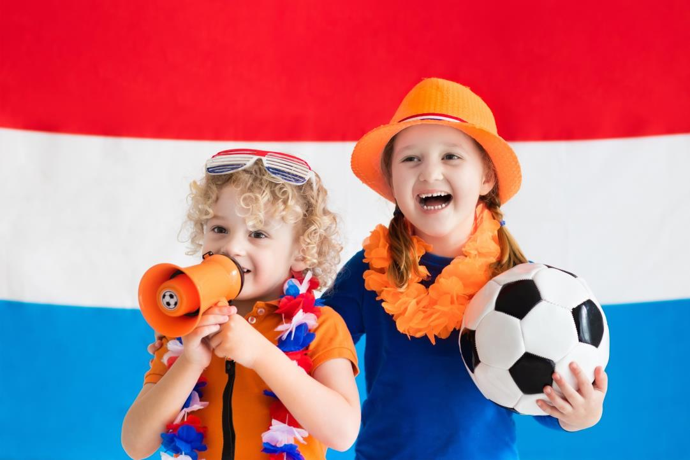
LEADING WITH ENCOURAGMENT

Slide 25
As leaders we want to see people THRIVE and released into their gifts so they can be all they were created to be. One of the main tools we have in this is encouragement. space
Many people struggle with FEARS and INSECURITIES, which often play over and over in their heads. space
Being an encourager doesn’t mean you can never CHALLENGE or CONFRONT anyone.
Encouragement STRENGTHENS our relationships - people love to be around positive people.

Slide 26
Sometimes it is because we don't want people to become ARROGANT.
space
However they may not be arrogant at all, and instead it may be that we are simply JEALOUS of them, and don't like seeing them do better than us.
space
Sometimes we withhold encouragement because we feel DISCOURAGED ourselves.

Slide 27
“Do whatever builds people up.
Criticism rarely does, but encouragement really does.”

